Slide 1


Connekt
Gaurav Basu
January 22nd, 2025

Slide 2
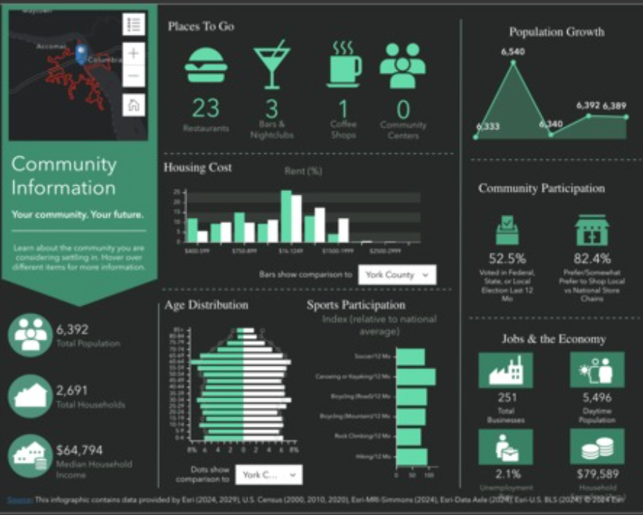
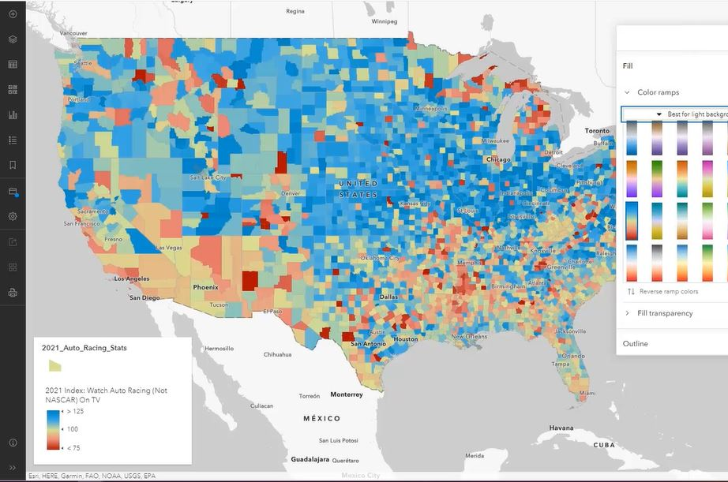
Connekt
Goal - Find the right place for you to work
User can select Home, Work location
User specifies desired commute distance
App finds overlapping area where user reach Home, Work and other area in desired time frame.
Connects with Zillow API to find rental properties in that area
Audience - College Graduates
Project Description

Slide 3
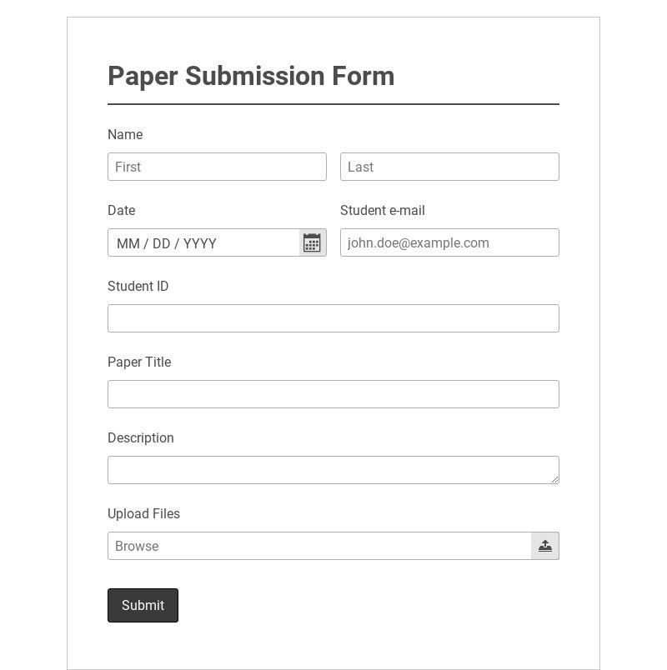
1.
2.
User POV

Slide 4
Why I’m Interested
Useful
Could be used to find new places to work
I like maps
Will have a large map
Uses a lot of ArcGIS
Business Analyst, ArcGIS for JS , etc
Page #

Slide 5

React + Vite
UntitledUI kit
ArcGIS JS SDK
Technologies
more!
Page #

Slide 6


Thank you + questions

